Slide 1
CS162 Operating Systems and Systems Programming Lecture 23 Key-Value Stores, Security
April 18th, 2018
Profs. Anthony D. Joseph & Jonathan Ragan-Kelley
http://cs162.eecs.Berkeley.edu

Slide 2
Key Value Storage
Can handle huge volumes of data, e.g., PetaBytes!
Store (key, value) tuples
Simple interface
put(key, value); // insert/write “value” associated with “key”
value = get(key); // get/read data associated with “key”
Used sometimes as a simpler but more scalable “database”

Slide 3





Key Values: Examples
Amazon:
Key: customerID
Value: customer profile (e.g., buying history, credit card, ..)
Facebook, Twitter:
Key: UserID
Value: user profile (e.g., posting history, photos, friends, …)
iCloud/iTunes:
Key: Movie/song name
Value: Movie, Song

Slide 4
Key-Value Storage Systems in Real Life
Amazon
DynamoDB: internal key value store used for Amazon.com (cart)
Simple Storage System (S3)
BigTable/HBase/Hypertable: distributed, scalable data store
Cassandra: “distributed data management system” (developed by Facebook)
Memcached: in-memory key-value store for small chunks of arbitrary data (strings, objects)
BitTorrent distributed file location: peer-to-peer sharing system
…

Slide 5
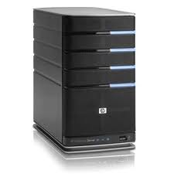
Key Value Store
Also called Distributed Hash Tables (DHT)
Main idea: partition set of key-values across many machines
key, value
…

Slide 6
Challenges
…
Fault Tolerance: handle machine failures without losing data and without degradation in performance
Scalability:
Need to scale to thousands of machines
Need to allow easy addition of new machines
Consistency: maintain data consistency in face of node failures and message losses
Heterogeneity (if deployed as peer-to-peer systems):
Latency: 1ms to 1000ms
Bandwidth: 32Kb/s to 100Mb/s

Slide 7
Key Questions
put(key, value): where to store a new (key, value) tuple?
get(key): where is the value associated with a given “key” stored?
And, do the above while providing
Fault Tolerance
Scalability
Consistency

Slide 8
Directory-Based Architecture
Directory maintains mapping between keys and machines (nodes) that store the values associated with the keys
Replicate value on several nodes for fault-tolerance
Scale by adding nodes, replicating Directory
Directory
put(K14, V14)
K5
N2
N1, N3
K14
N1,N3
K105
N50
put(K14, V14)
put(K14, V14), N1
K14
V14
K5
V5
K14
V14
K105
V105
…
N₁
N₂
N₃
N₅₀

Slide 9
Directory-Based Architecture
Directory maintains mapping between keys and machines (nodes) that store the values associated with the keys
Replicate value on several nodes for fault-tolerance
Scale by adding nodes, replicating Directory
Directory
get(K14)
K5
N2
V14
K14
N1,N3
K105
N50
get(K14)
V14
K14
V14
K5
V5
K14
V14
K105
V105
…
N₁
N₂
N₃
N₅₀

Slide 10
Consistency
Need to make sure that a value is replicated correctly
How do you know a value has been replicated on every node?
Wait for acknowledgements from every node
What happens if a node fails during replication?
Pick another node and try again
What happens if a node is slow?
Slow down the entire put()? Pick another node?
In general, with multiple replicas
Slow puts and fast gets

Slide 11
Large Variety of Consistency Models
Atomic consistency (linearizability): reads/writes (gets/puts) to replicas appear as if there was a single underlying replica (single system image)
Think “one updated at a time”
Transactions
Eventual consistency: given enough time all updates will propagate through the system
One of the weakest form of consistency; used by many systems in practice
Must eventually converge on single value/key (coherence)
And many others: causal consistency, sequential consistency, strong consistency, …

Slide 12
Quorum Consensus
Improve put() and get() operation performance
Define a replica set of size N
put() waits for acknowledgements from at least W replicas
get() waits for responses from at least R replicas
W+R > N
Why does it work?
There is at least one node that contains the update
Why might you use W+R > N+1?

Slide 13
Quorum Consensus Example
N=3, W=2, R=2
Replica set for K14: {N₁, N₃, N₄}
Assume put() on N₃ fails
put(K14, V14)
put(K14, V14)
put(K14, V14)
ACK
ACK
K14
V14
K14
V14
N₁
N₂
N₃
N₄

Slide 14
Quorum Consensus Example
Now, issuing get() to any two nodes out of three will return the answer
get(K14)
get(K14)
V14
NIL
K14
V14
K14
V14
N₁
N₂
N₃
N₄

Slide 15


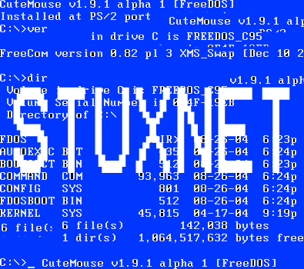




What is Computer Security Today?
Computing in the presence of an adversary!
Adversary is the security field’s defining characteristic
Reliability, robustness, and fault tolerance
Dealing with Mother Nature (random failures)
Security
Dealing with actions of a knowledgeable attacker dedicated to causing harm
Surviving malice, and not just mischance
Wherever there is an adversary, there is a computer security problem!
? ??? million
70-110 million users
.5 million
hosts
? ??? million
56 million users
BlackEnergy
SCADA malware
? ??? million
Mirai IoT botnet
83 million users

Slide 16
Protection vs. Security
Protection: mechanisms for controlling access of programs, processes, or users to resources
Page table mechanism
Round-robin schedule
Data encryption
Security: use of protection mech. to prevent misuse of resources
Misuse defined with respect to policy
E.g.: prevent exposure of certain sensitive information
E.g.: prevent unauthorized modification/deletion of data
Need to consider external environment the system operates in
Most well-constructed system cannot protect information if user accidentally reveals password – social engineering challenge

Slide 17
Security Requirements
Authentication
Ensures that a user is who is claiming to be
Data integrity
Ensure that data is not changed from source to destination or after being written on a storage device
Confidentiality
Ensures that data is read only by authorized users
Non-repudiation
Sender/client can’t later claim didn’t send/write data
Receiver/server can’t claim didn’t receive/write data

Slide 18
Securing Communication: Cryptography
Cryptography: communication in the presence of adversaries
Studied for thousands of years
See the Simon Singh’s The Code Book for an excellent, highly readable history
Central goal: confidentiality
How to encode information so that an adversary can’t extract it, but a friend can
General premise: there is a key, possession of which allows decoding, but without which decoding is infeasible
Thus, key must be kept secret and not guessable

Slide 19
Using Symmetric Keys
Same key for encryption and decryption
Achieves confidentiality
Vulnerable to tampering and replay attacks
Plaintext (m)
m
Internet
Encrypt with
secret key
Decrypt with
secret key
Ciphertext

Slide 20
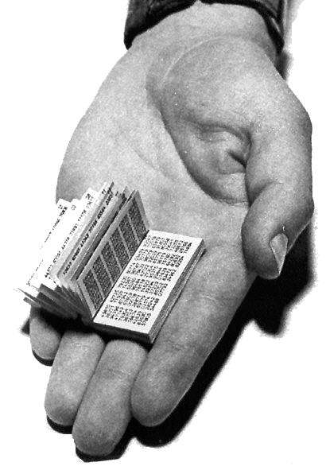
Symmetric Keys
Can just XOR plaintext with the key
Easy to implement, but easy to break using frequency analysis
Unbreakable alternative: XOR with one-time pad
Use a different key for each message

Slide 21
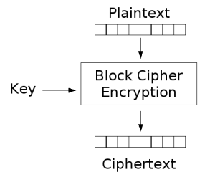
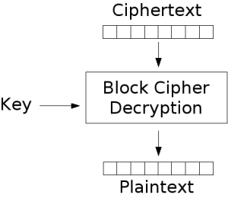
Block Ciphers with Symmetric Keys
More sophisticated (e.g., block cipher) algorithms
Works with a block size (e.g., 64 bits)
Can encrypt blocks separately:
Same plaintext⇒same ciphertext
Much better:
Add in counter and/or link ciphertext of previous block

Slide 22
Symmetric Key Ciphers - DES & AES
Data Encryption Standard (DES)
Developed by IBM in 1970s, standardized by NBS/NIST
56-bit key (decreased from 64 bits at NSA’s request)
Still fairly strong other than brute-forcing the key space
But custom hardware can crack a key in < 24 hours
Today many financial institutions use Triple DES
DES applied 3 times, with 3 keys totaling 168 bits
Advanced Encryption Standard (AES)
Replacement for DES standardized in 2002
Key size: 128, 192 or 256 bits
How fundamentally strong are they?
No one knows (no proofs exist)

Slide 23
Authentication in Distributed Systems
What if identity must be established across network?
Need way to prevent exposure of information while still proving identity to remote system
Many of the original UNIX tools sent passwords over the wire “in clear text”
E.g.: telnet, ftp, yp (yellow pages, for distributed login)
Result: Snooping programs widespread
What do we need? Cannot rely on physical security!
Encryption: Privacy, restrict receivers
Authentication: Remote Authenticity, restrict senders
Network
PASS: gina

Slide 24
Authentication via Secret Key
Main idea: entity proves identity by decrypting a secret encrypted with its own key
K – secret key shared only by A and B
A can asks B to authenticate itself by decrypting a nonce, i.e., random value, x
Avoid replay attacks (attacker impersonating client or server)
Vulnerable to man-in-the middle attack
A
B
E(x, K)
Notation: E(m,k) – encrypt message m with key k
x

Slide 25
Administrivia
Midterm 3 Review: Fri 4/20 7:00-10:00PM (VLSB 2050)
Midterm 3 coming up on Wed 4/25 6:30-8PM
All topics up to and including Lecture 23
Focus will be on Lectures 17 – 23 and associated readings, and Projects 3
But expect 20-30% questions from materials from Lectures 1-16
LKS 245, Hearst Field Annex A1, VLSB 2060, Barrows 20, Wurster 102 (see Piazza for your room assignment)
Closed book
2 pages hand-written notes both sides

Slide 26
break

Slide 27
Secure Hash Function
Hash Function: Short summary of data (message)
For instance, h₁=H(M₁) is the hash of message M₁
h₁ fixed length, despite size of message M₁
Often, h₁ is called the “digest” of M₁
Hash function H is considered secure if
It is infeasible to find M₂ with h₁=H(M₂); i.e., can’t easily find other message with same digest as given message
It is infeasible to locate two messages, m₁ and m₂, which “collide”, i.e. for which H(m₁) = H(m₂)
A small change in a message changes many bits of digest/can’t tell anything about message given its hash
Fox
Hash
Function
DFCD3454BBEA788A
751A696C24D97009
CA992D17
The red fox
runs across
the ice
Hash
Function
52ED879E70F71D92
6EB6957008E03CE4
CA6945D3

Slide 28
Integrity: Cryptographic Hashes
Basic building block for integrity: cryptographic hashing
Associate hash with byte-stream, receiver verifies match
Assures data hasn’t been modified, either accidentally – or maliciously
Approach:
Sender computes a secure digest of message m using H(x)
H(x) is a publicly known hash function
Digest d = HMAC (K, m) = H (K | H (K | m))
HMAC(K, m) is a hash-based message authentication function
Send digest d and message m to receiver
Upon receiving m and d, receiver uses shared secret key, K, to recompute HMAC(K, m) and see whether result agrees with d

Slide 29
Using Hashing for Integrity
plaintext (m)
corrupted msg
m
NO
=
digest’
Internet
Digest
HMAC(K,m)
Digest
HMAC(K,m)
Encrypted Digest
Unencrypted Message
Can encrypt m for confidentiality

Slide 30
Standard Cryptographic Hash Functions
MD5 (Message Digest version 5)
Developed in 1991 (Rivest), produces 128 bit hashes
Widely used (RFC 1321)
Broken (1996-2008): attacks that find collisions
SHA-1 (Secure Hash Algorithm)
Developed in 1995 (NSA) as MD5 successor with 160 bit hashes
Widely used (SSL/TLS, SSH, PGP, IPSEC)
Broken in 2005, government use discontinued in 2010
SHA-2 (2001)
Family of SHA-224, SHA-256, SHA-384, SHA-512 functions
HMAC’s are secure even with older “insecure” hash functions

Slide 31
Key Distribution
How do you get shared secret to both places?
For instance: how do you send authenticated, secret mail to someone who you have never met?
Must negotiate key over private channel
Exchange code book/key cards/memory stick/others
Could use a third party

Slide 32
Third Party: Authentication Server (Kerberos)
Notation:
K_{xy} is key for talking between x and y
(…)^{K} means encrypt message (…) with the key K
Clients: A and B, Authentication server S
Usage:
A asks server for key:
A→S: [Hi! I’d like a key for talking between A and B]
Not encrypted. Others can find out if A and B are talking
Server returns session key encrypted using B’s key
S→A: Message [ Use K_{ab} (This is A! Use K_{ab})^{Ksb} ] ^{Ksa}
This allows A to know, “S said use this key”
Whenever A wants to talk with B
A→B: Ticket [ This is A! Use K_{ab} ]^{Ksb}
Now, B knows that K_{ab} is sanctioned by S

Slide 33
Authentication Server Continued [Kerberos]
Key
Server
Req Ticket
Ticket
Ticket
Secure Communication
Details
Both A and B use passwords (shared with key server) to decrypt return from key servers
Add in timestamps to limit how long tickets will be used to prevent attacker from replaying messages later
Also have to include encrypted checksums (hashed version of message) to prevent malicious user from inserting things into messages/changing messages
Kerberos is the system that holds all CalNet IDs and passphrases

Slide 34
Asymmetric Encryption (Public Key)
Idea: use two different keys, one to encrypt (e) and one to decrypt (d)
A key pair
Crucial property: knowing e does not give away d
Therefore e can be public: everyone knows it!
If Alice wants to send to Bob, she fetches Bob’s public key (say from Bob’s home page) and encrypts with it
Alice can’t decrypt what she’s sending to Bob …
… but then, neither can anyone else (except Bob)

Slide 35
Public Key / Asymmetric Encryption
Sender uses receiver’s public key
Advertised to everyone
Receiver uses complementary private key
Must be kept secret
Plaintext
Plaintext
Internet
Encrypt with
public key
Decrypt with
private key
Ciphertext

Slide 36
Public Key Encryption Details
Idea: K_{public} can be made public, keep K_{private} private
Gives message privacy (restricted receiver):
Public keys (secure destination points) can be acquired by anyone/used by anyone
Only person with private key can decrypt message
What about authentication?
Use combination of private and public key
Alice→Bob: [(I’m Alice)^{Aprivate} Rest of message]^{Bpublic}
Provides restricted sender and receiver
But: how does Alice know that it was Bob who sent her B_{public}? And vice versa…
Insecure Channel
B_{public}
B_{private}
A_{private}
A_{public}
Alice
Insecure Channel
Bob

Slide 37
Public Key Cryptography
Invented in the 1970s
Revolutionized cryptography
(Was actually invented earlier by British intelligence)
How can we construct an encryption/decryption algorithm using a key pair with the public/private properties?
Answer: Number Theory
Most fully developed approach: RSA
Rivest / Shamir / Adleman, 1977; RFC 3447
Based on modular multiplication of very large integers
Very widely used (e.g., ssh, SSL/TLS for https)
Also mature approach: Eliptic Curve Cryptography (ECC)
Based on curves in a Galois-field space
Shorter keys and signatures than RSA

Slide 38
Properties of RSA
Requires generating large, random prime numbers
Algorithms exist for quickly finding these (probabilistic!)
Requires exponentiation of very large numbers
Again, fairly fast algorithms exist
Overall, much slower than symmetric key crypto
One general strategy: use public key crypto to exchange a (short) symmetric session key
Use that key then with AES or such
How difficult is recovering d, the private key?
Equivalent to finding prime factors of a large number
Many have tried - believed to be very hard (= brute force only)
(Though quantum computers could do so in polynomial time!)
Notes:
Shor’s algorithm is polynomial in log N

Slide 39
Simple Public Key Authentication
Each side need only to know the other side’s public key
No secret key need be shared
A encrypts a nonce (random num.) x
Avoid replay attacks, e.g., attacker impersonating client or server
B proves it can recover x, generates second nonce y
A can authenticate itself to B in the same way
A and B have shared private secrets on which to build private key!
We just did secure key distribution!
Many more details to make this work securely in practice!
A
B
E({x, A}, Public_{B})
E({x, y, B}, Public_{A})
E({y, A}, Public_{B})
Notation: E(m,k) – encrypt message m with key k

Slide 40
Non-Repudiation: RSA Crypto & Signatures
Suppose Alice has published public key KE
If she wishes to prove who she is, she can send a message x encrypted with her private key KD (i.e., she sends E(x, KD))
Anyone knowing Alice’s public key KE can recover x, verify that Alice must have sent the message
It provides a signature
Alice can’t deny it: non-repudiation
Could simply encrypt a hash of the data to sign a document that you wanted to be in clear text
Note that either of these signature techniques work perfectly well with any data (not just messages)
Could sign every datum in a database, for instance

Slide 41
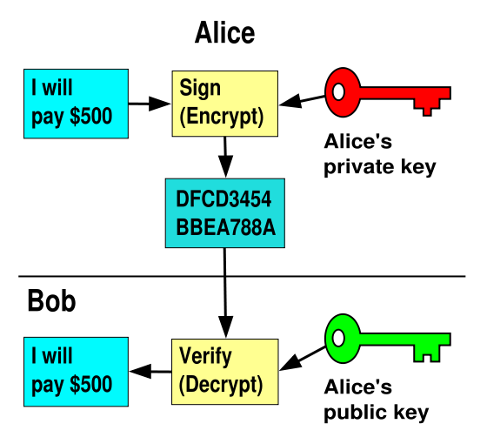
RSA Crypto & Signatures (cont’d)
I will pay Bob $500
I will pay Bob $500

Slide 42
Digital Certificates
How do you know K_{E} is Alice’s public key?
Trusted authority (e.g., Verisign) signs binding between Alice and K_{E} with its private key KV_{private}
C = E({Alice, K_{E}}, KV_{private})
C: digital certificate
Alice: distribute her digital certificate, C
Anyone: use trusted authority’s KV_{public}, to extract Alice’s public key from C
D(C, KV_{public}) = D(E({Alice, K_{E}}, KV_{private}), KV_{public}) = {Alice, K_{E}}

Slide 43
Summary of Our Crypto Toolkit
If we can securely distribute a key, then
Symmetric ciphers (e.g., AES) offer fast, presumably strong confidentiality
Public key cryptography does away with (potentially major) problem of secure key distribution
But: not as computationally efficient
Often addressed by using public key crypto to exchange a session key
Digital signature binds the public key to an entity

Slide 44
Putting It All Together - HTTPS
What happens when you click on https://www.amazon.com?
https = “Use HTTP over SSL/TLS”
SSL = Secure Socket Layer
TLS = Transport Layer Security
Successor to SSL
Provides security layer (authentication, encryption) on top of TCP
Fairly transparent to applications

Slide 45
HTTPS Connection (SSL/TLS) (cont’d)
Browser (client) connects via TCP to Amazon’s HTTPS server
Client sends over list of crypto protocols it supports
Server picks protocols to use for this session
Server sends over its certificate
(all of this is in the clear)
Browser
Amazon
Hello. I support
(TLS+RSA+AES128+SHA2) or
(SSL+RSA+3DES+MD5) or …
Let’s use
TLS+RSA+AES128+SHA2
Here’s my cert
~1 KB of data

Slide 46
Inside the Server’s Certificate
Name associated with cert (e.g., Amazon)
Amazon’s RSA public key
A bunch of auxiliary info (physical address, type of cert, expiration time)
Name of certificate’s signatory (who signed it)
A public-key signature of a hash (SHA-256) of all this
Constructed using the signatory’s private RSA key, i.e.,
Cert = E(H_{SHA256}(KA_{public}, www.amazon.com, …), KS_{private}))
KA_{public}: Amazon’s public key
KS_{private}: signatory (certificate authority) private key
…

Slide 47
Validating Amazon’s Identity
How does the browser authenticate certificate signatory?
Certificates of several certificate authorities (e.g., Verisign) are hardwired into the browser (or OS)
If can’t find cert, warn user that site has not been verified
And may ask whether to continue
Note, can still proceed, just without authentication
Browser uses public key in signatory’s cert to decrypt signature
Compares with its own SHA-256 hash of Amazon’s cert
Assuming signature matches, now have high confidence it’s indeed Amazon … assuming signatory is trustworthy
DigiNotar CA breach (July-Sept 2011): Google, Yahoo!, Mozilla, Tor project, Wordpress, … (531 total certificates)
Notes:
Wikipedia: DigiNotar was a Dutch certificate authority owned by VASCO Data Security International.^{[1]} On September 3, 2011, after it had become clear that a security breach had resulted in the fraudulent issuing of certificates, the Dutch government took over operational management of DigiNotar's systems.^{[2]} That same month, the company was declared bankrupt. (Wikipedia)

Slide 48
Certificate Validation
Certificate
E(H_{SHA256}(KA_{public}, www.amazon.com, …), KS_{private})),
KA_{public}, www.amazon.com, …
E(H_{SHA256}(…), KS_{public}))
(recall, KS_{public} hardwired)
H_{SHA256}(KA_{public}, www.amazon.com, ..)
H_{SHA256}(KA_{public}, www.amazon.com, …)
H_{SHA256}(KA_{public}, www.amazon.com, …)
No
=
Validation failed
Yes
Validation successful
Can also validate using peer approach: https://www.eff.org/observatory

Slide 49
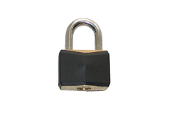
HTTPS Connection (SSL/TLS) cont’d
Browser constructs a random session key K used for data communication
Private key for bulk crypto
Browser encrypts K using Amazon’s public key
Browser sends E(K, KA_{public}) to server
Browser displays
All subsequent comm. encrypted w/ symmetric cipher (e.g., AES128) using key K
E.g., client can authenticate using a password
Browser
Amazon
Here’s my cert
~1 KB of data
K
E(K, KA_{public})
Agreed
K
E(password …, K)
E(response …, K)

Slide 50
Summary
Key-Value Store:
Two operations
put(key, value)
value = get(key)
Challenges
Fault Tolerance → replication
Scalability → serve get()’s in parallel; replicate/cache hot tuples
Consistency → quorum consensus to improve put() performance
Security:
Many more challenges to building secure systems and applications
No fixed-point solutions
Adversaries constantly change and adapt
Defenses must also constantly change and adapt
Take CS 161 !

